Slide 1
Initialization of Objects in Real-Drive Scenarios Using Automotive Radar Data and Deep Neural Networks
Environment Recognition and Machine Learning Automated Driving
EF-601

Slide 2
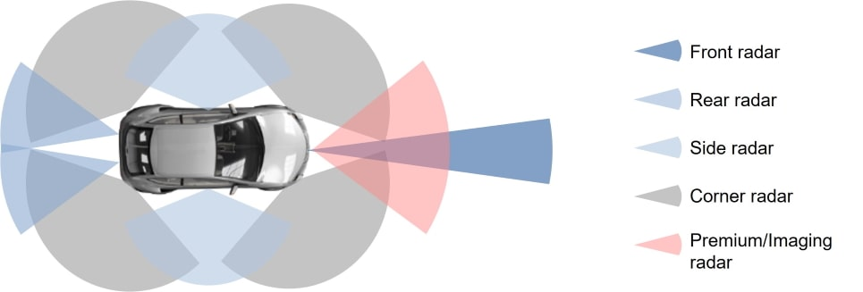
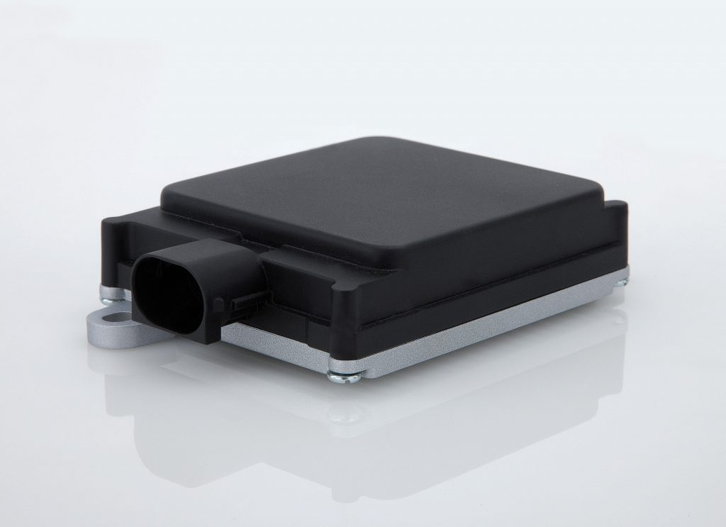
Radar perception
Long Range Radar
Mid Range Radar
Short range radar
Ultra short range radar

Slide 3
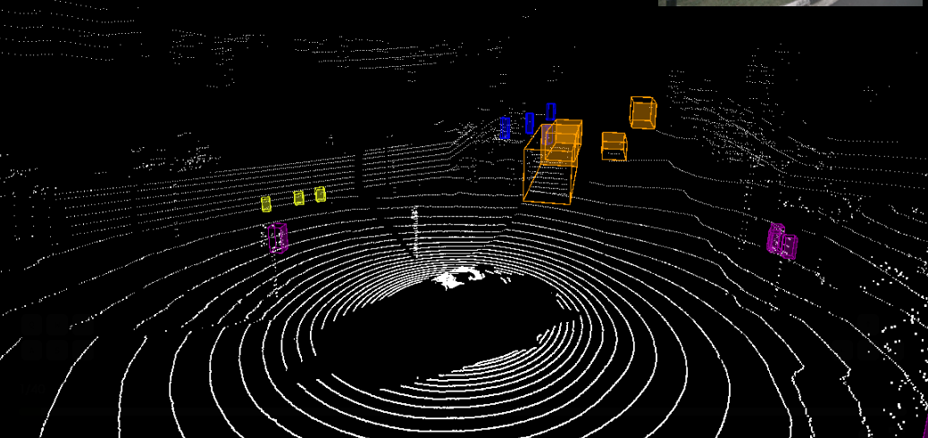
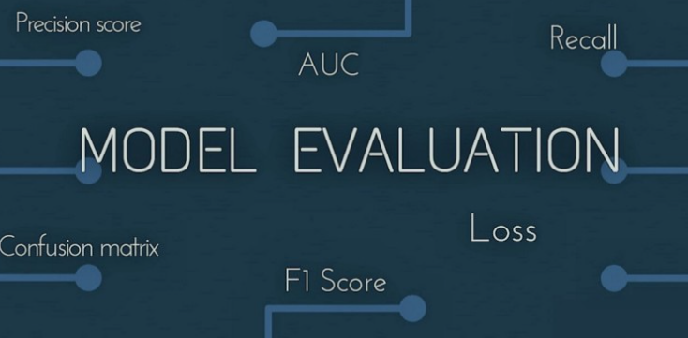
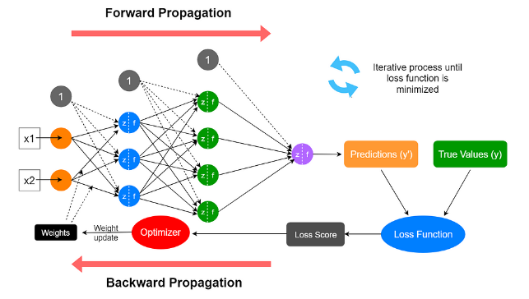
OBJECTIVES
Develop a DNN-based Model for Object Initialization
Evaluate Object Initialization with Sparse Data
Optimize Initialization Cycles
Validate Against Existing Object Tracker Data
CNN,RNN,
Transformers,
Cross/Multi- Model

Slide 4
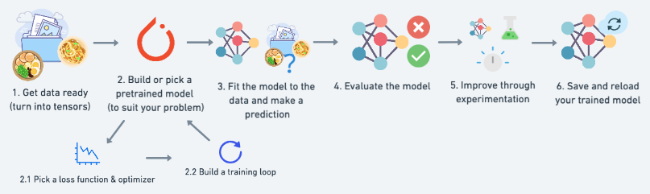
WORKFLOW
Analysis of results
Literature Review
Data Collection and Preprocessing
Model Development
Model Evaluation and Optimization
Validation and Comparison
to understand the model's performance in terms of accuracy, data sparsity, and initialization cycle efficiency
Identify potential limitations and areas for further research.
The successful completion of this thesis could significantly enhance the capabilities of ADAS and autonomous systems in object detection and tracking

Slide 5
REQUIREMENTS
VALIDATION PROCEDURE
Literature Review
Analysis of Results
Data Collection &
Preprocessing
Validation Against Tracker Data
Model Development
Model Evaluation & Optimization
Object Initialization Optimization
System Integration
Implementation

Slide 6
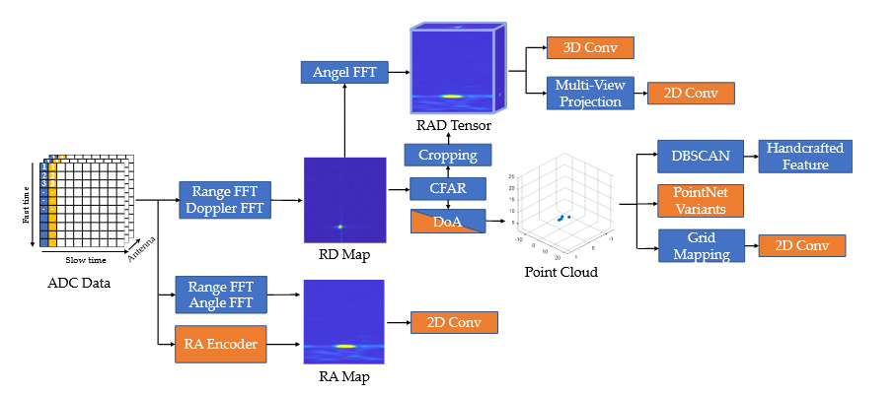
Radar detection frameworks

Slide 7
Exploring Radar Data Representations
ADC signal (Raw Output)
radar tensor (2D, 3D, 4D)
point cloud (Clustering-Based, Point-Based, Voxel-Based)
grid map (Occupancy-Based, Amplitude-Based)
micro-Doppler signature

Slide 8
Data Type | Applications | Advantages | Limitations
ADC Signal | • Classification • Object Detection • Vital Sign Monitoring | • Contains all information from raw radar data • High temporal resolution • Fine-grained feature recognition | • Lack of semantic information • Complexity in data processing • Sensitive to noise
Radar Tensor | • Classification • Detection • Segmentation • Localization | • Provides spatial structure with range, azimuth and elevation • Provides rich motion information about the object | • Retains interference information around the object • Inconsistent resolution between range and azimuth
Point Cloud | • Detection • Segmentation • Tracking • Odometry | • Offers 3D spatial representation of the surrounding environment • Light-weight representation for objects • Filters weak reflected signals | • Sparse in describing the shape of objects • Susceptible to noise and occlusion • Loss of potential information after CFAR processing
Grid Map | • Mapping • Localization • Odometry • Detection | • Provides structured BEV representation of the surroundings • Offers a concise representation focusing on presence and occupancy | • Difficulty in representing complex and dynamic scenes • Suffers from noise, occlusions, and resolution
Micro-Doppler Signature | • Motion Classification • Vital Sign Monitoring | • Contains information about object motion • Enhances differentiation between objects | • Limited resolution in range estimation • Vulnerable to noise and interference

Slide 9
Typical automotive radar parameters
(Feature Engineering)
Azimuth
Elevation
Range
RCS
Doppler
SNR
Time
Spatial Features (x, y, z)

Slide 10
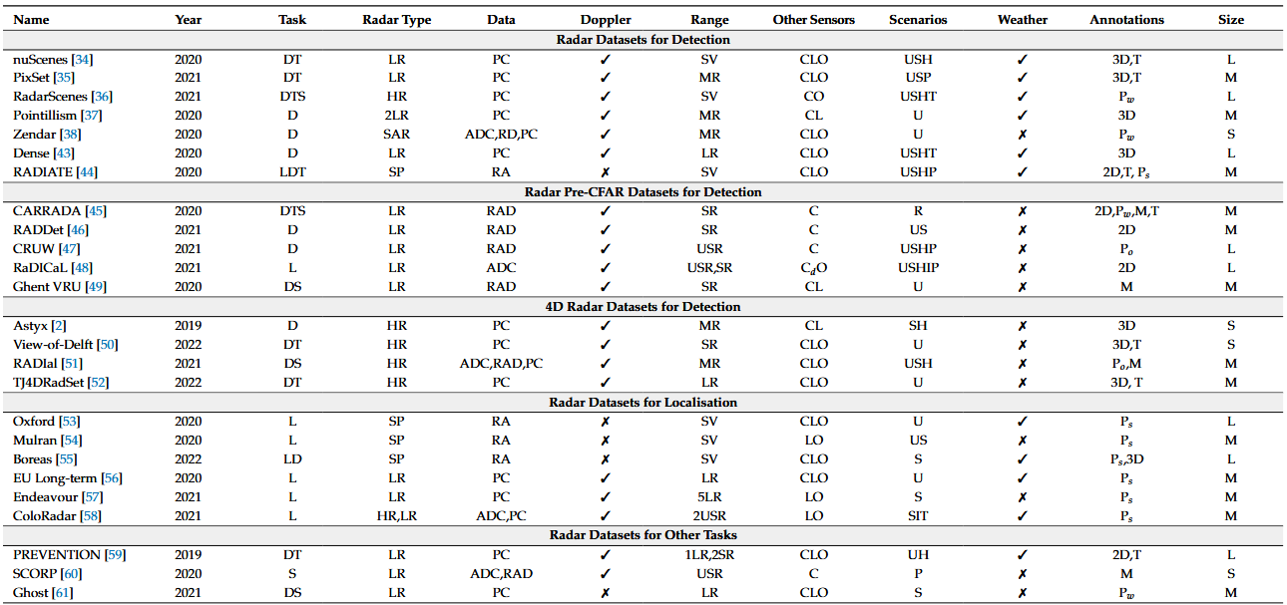
Radar datasets

Slide 11
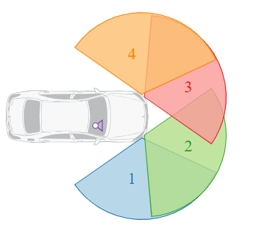
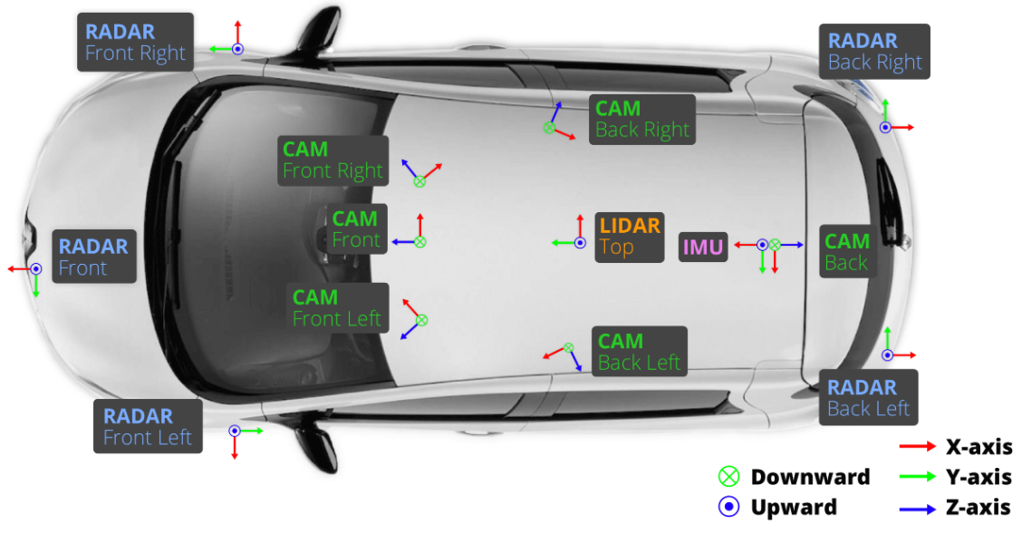
Sensor Setup
RadarScenes
nuScenes

Slide 12
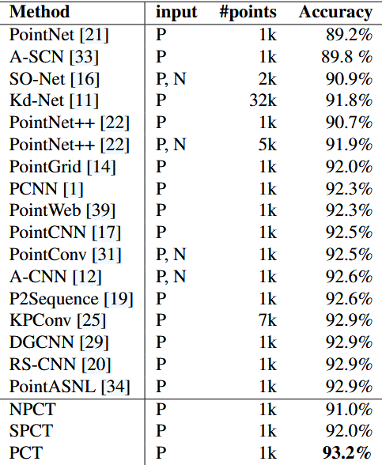
Deep Learning Architectures for Point Clouds

Slide 13
To Predict Heading direction and Shape :-
Spatio-Temporal Encoder-Decoder Architecture
cnn‐based heading direction estimation method
ConvLSTMs
Video prediction approach called FutureGAN
point recurrent neural network
GCNN
Point Net ++
Point cloud Transformer
Multi-Model

